Slide 1
QMST 5335
Module 2.2
Queueing Analyses, Cases, and More

Slide 2
Learning Objectives:
Understanding basic approaches used to evaluate queueing systems and compare design alternatives
Learning how to analyze various performance requirements
Learning how to analyze economics of various queueing systems
Getting familiar with Priority queues
Learning basics of system of connected queueing systems

Slide 3
Outline
Evaluating Queueing Systems
Analyses
  Systematic Analyses: Case – Car Charging Station Design
  Economic Analyses: Case – Workstation Setup Design
Further concepts
  Priority Queues
  Queueing Networks

Slide 4
Outline
Evaluating Queueing Systems
Analyses
  Systematic Analyses: Case – Car Charging Station Design
  Economic Analyses: Case – Workstation Setup Design
Further concepts
  Priority Queues
  Queueing Networks

Slide 5
Evaluating Queueing Systems
Economic Analyses: Basics
Managers are often interested in the costs/profits
  Typically, these costs will be defined considering time
    $5 per hour, $10 per minute, etc.
  There are two main sources of costs
    Servers: Employee cost, machine cost, etc.
      Expected total server cost/hour = (expected cost of a server/hour) X (# of servers)
      Need to pay attention if server cost is fixed or depends on busy/idle status
    Customers: waiting costs, penalties paid
      Expected total customer cost/hour = (expected cost of a customer) X (exp. # of customers/hour)
      Need to pay attention if customer cost depends on W, Wq or some other specifics
  It is useful to calculate the average (expected) cost/profit of a system
    So that we can compare different alternatives in terms of costs/profits or others

Slide 6
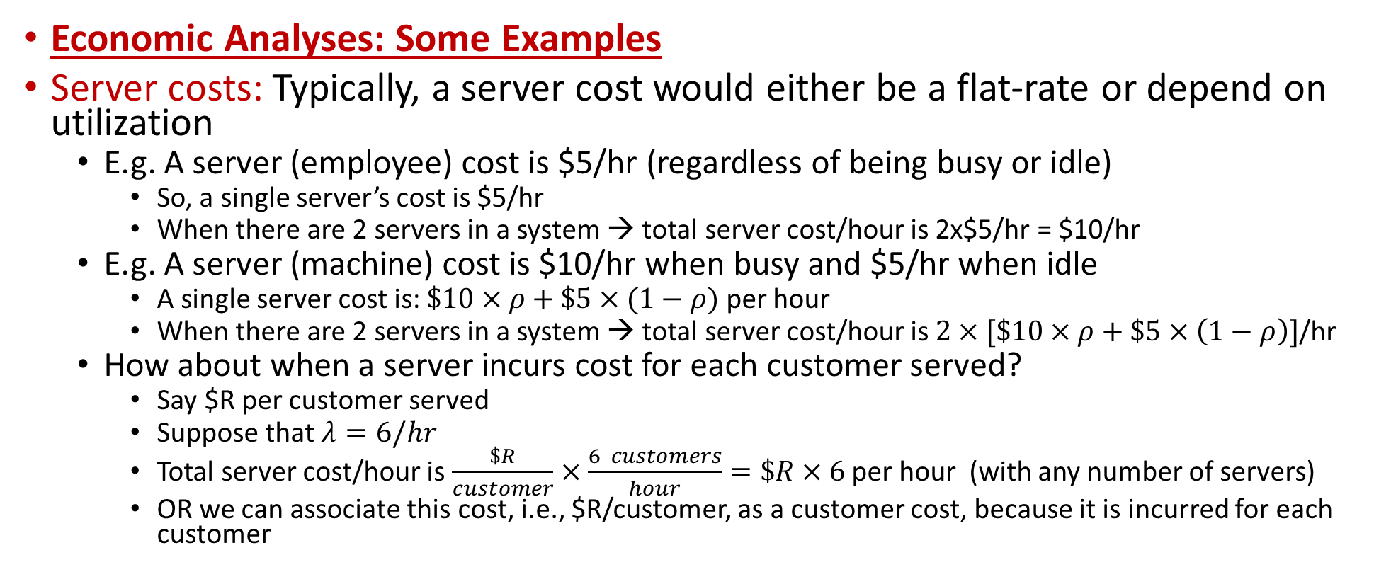
Evaluating Queueing Systems
Economic Analyses: Some Examples
Server costs: Typically, a server cost would either be a flat-rate or depend on utilization
  E.g. A server (employee) cost is $5/hr (regardless of being busy or idle)
    So, a single server’s cost is $5/hr
    When there are 2 servers in a system → total server cost/hour is 2x$5/hr = $10/hr
  E.g. A server (machine) cost is $10/hr when busy and $5/hr when idle
    A single server cost is: $\$10×ρ+\$5×(1−ρ)$ per hour
    When there are 2 servers in a system → total server cost/hour is $2×[\$10×ρ+\$5×\left(1−ρ\right)]$/hr
  How about when a server incurs cost for each customer served?
    Say $R per customer served
    Suppose that $λ=6/hr$
    Total server cost/hour is $\frac{\$R}{customer}×\frac{6 customers}{hour}=\$R×6$ per hour (with any number of servers)
    OR we can associate this cost, i.e., $R/customer, as a customer cost, because it is incurred for each customer

Slide 7
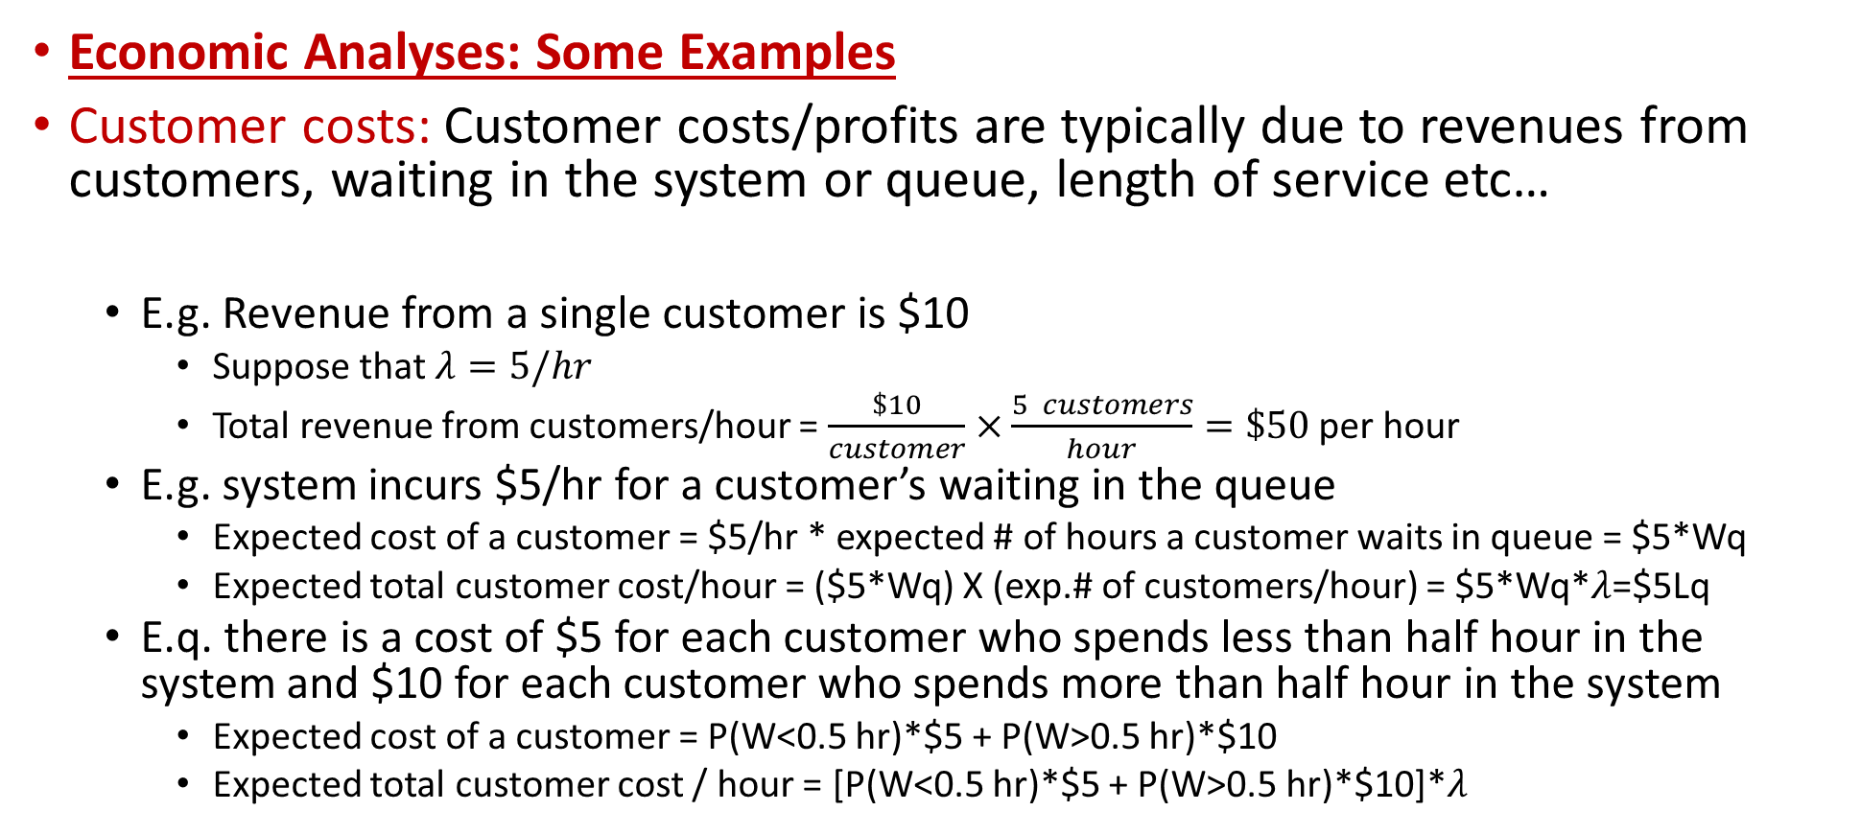
Evaluating Queueing Systems
Economic Analyses: Some Examples
Customer costs: Customer costs/profits are typically due to revenues from customers, waiting in the system or queue, length of service etc…
  E.g. Revenue from a single customer is $10
    Suppose that $λ=5/hr$
    Total revenue from customers/hour = $\frac{\$10}{customer}×\frac{5 customers}{hour}=\$50$ per hour
  E.g. system incurs $5/hr for a customer’s waiting in the queue
    Expected cost of a customer = $5/hr * expected # of hours a customer waits in queue = $5*Wq
    Expected total customer cost/hour = ($5*Wq) X (exp.# of customers/hour) = $5*Wq*$λ$=$5Lq
  E.q. there is a cost of $5 for each customer who spends less than half hour in the system and $10 for each customer who spends more than half hour in the system
    Expected cost of a customer = P(W<0.5 hr)*$5 + P(W>0.5 hr)*$10
    Expected total customer cost / hour = [P(W<0.5 hr)*$5 + P(W>0.5 hr)*$10]*$λ$
Expected total customer cost/hour = (expected cost of a customer) X (exp. # of customers/hour)

Slide 8
Evaluating Queueing Systems
Systematic Analyses: Basics
Managers might be interested in achieving standards (goals)
  Recall that we defined the key performance measures: L, Lq, W, Wq
  These are important measures in analyzing queueing systems
    Compare alternative servers (machine 1 vs. machine 2)
    Compare alternative systems (1 server vs. 2 servers vs. 3 servers)
  In addition to these measures, managers might be interested in achieving specific standards (goals) in their systems (such as service quality goals)
    At most XX% of customers wait more than YY time units in the system (or queue)
    At least ZZ% of the time, there should be TT or less customers in the system (or queue)
  We can analyze such standards using analytical results (or simulation)
    Probability of a customer waiting in the system or in the queue more than YY time units should be less than XX%
    Probability of having TT or less customers in the system or in the queue should be less than ZZ%

Slide 9
Evaluating Queueing Systems
Systematic Analyses: Some Examples
  If the standard is about average number is the system, check L
  If the standard is about average number in the queue, check Lq
  If the standard is about average time of customer in the system, check W
  If the standard is about average time of a customer in the queue, check Wq
  If the standard is about % of time there are <=a customers in the system
    Check p(0)+p(1)+…+p(a), where p(n) is the probability of n customers in system
  If the standard is about % of time there are <=b customers in the queue
    Check p(0)+p(1)+..+p(b)+p(b+1)+…+p(b+c), where c is the number of servers
  If the standard is about % of customers waiting in queue <=t time units
    Check P(Wq<t time units)
  If the standard is about % of customers waiting in system <=t time units
    Check P(W<t time units)

Slide 10
Outline
Evaluating Queueing Systems
Analyses
  Systematic Analyses: Case – Car Charging Station Design
  Economic Analyses: Case – Workstation Setup Design
Further concepts
  Priority Queues
  Queueing Networks

Slide 11
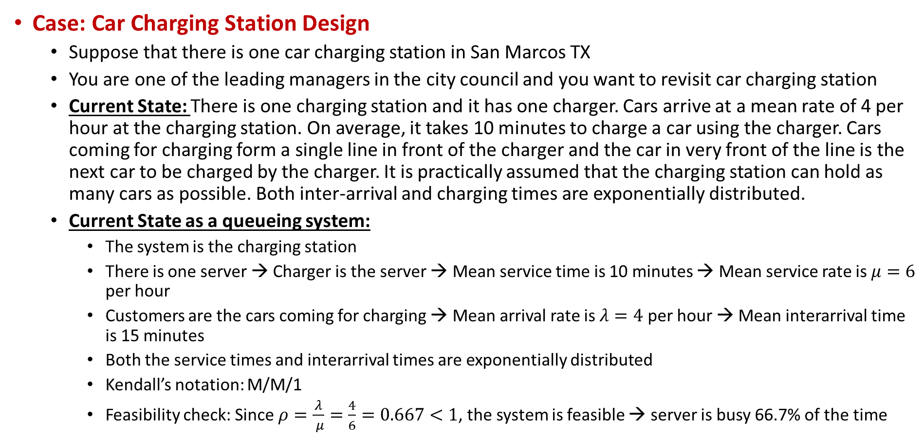
Case Study – Systematic Analyses
Case: Car Charging Station Design
  Suppose that there is one car charging station in San Marcos TX
  You are one of the leading managers in the city council and you want to revisit car charging station
  Current State: There is one charging station and it has one charger. Cars arrive at a mean rate of 4 per hour at the charging station. On average, it takes 10 minutes to charge a car using the charger. Cars coming for charging form a single line in front of the charger and the car in very front of the line is the next car to be charged by the charger. It is practically assumed that the charging station can hold as many cars as possible. Both inter-arrival and charging times are exponentially distributed.
  Current State as a queueing system:
    The system is the charging station
    There is one server → Charger is the server → Mean service time is 10 minutes → Mean service rate is $μ=6$ per hour
    Customers are the cars coming for charging → Mean arrival rate is $λ=4$ per hour → Mean interarrival time is 15 minutes
    Both the service times and interarrival times are exponentially distributed
    Kendall’s notation: M/M/1
    Feasibility check: Since $ρ=\frac{λ}{ μ}=\frac{4}{6}=0.667<1$, the system is feasible → server is busy 66.7% of the time

Slide 12
Case Study – Systematic Analyses
Case: Car Charging Station Design
  Current State key performance measures:
    Since this is a M/M/1 system, we can use formulae, or we can use the template
  With the current system, the city council has been receiving complaints
    A car owner is very-satisfied if she starts charging her car as soon as she arrives at the station
    A car owner is satisfied if she starts charging her car within 10 minutes of her arrival
    A car owner is unsatisfied if she starts charging her car 10 or more minutes after her arrival
    City council wants to achieve the following standards:
      At least 40% of the customers be very-satisfied on average
      At least 80% of the customers be satisfied or very-satisfied on average (or equally, at most 20% of the customers are unsatisfied on average)
    What are these standards?
      A car owner’s satisfaction depends on the time she spends from her arrival until she starts charging
      That is, her waiting time in the queue
      We know that on average, a car owner waits Wq=0.3333 hours = 20 minutes on average in the queue
      But the standards are not about average waiting time!

Slide 13
Case Study – Systematic Analyses
Case: Car Charging Station Design
  Standards:
  At least 40% of the customers be very-satisfied on average
    A car owner is very-satisfied if she does not wait in the queue at all
    % of car owners waiting less than XX minutes is probability of a car owner waiting less than XX minutes
    So, we need to determine the probability of a car owner wait 0 minutes in the queue
    P(Wq<0) = 1- P(Wq>0)
    We can use template to calculate this
    So, the current system does not satisfy this standard ☹
    Note: P(Wq<0) =p(0) in this example! Why?
Here, there is abuse of notation as Wq here refers to a generic queue time rather than expected queue time of a customer

Slide 14
Case Study – Systematic Analyses
Case: Car Charging Station Design
  Standards:
  At least 80% of the customers be satisfied or very-satisfied on average
    A car owner is satisfied or very-satisfied if she does not wait in the queue more than 10 minutes
    So, we need to determine the probability of a car owner wait 10 minutes or less in the queue
    P(Wq<10minutes) = 1- P(Wq>10minutes)
      be careful with metrics! Everything should be in terms of hours or minutes (I used hours for λ and μ)
    We can use template to calculate this
    So, the current system does not satisfy this standard also ☹
    We can also calculate:
{% of satisfied or very-satisfied} – {% of very satisfied}

Slide 15
Case Study – Systematic Analyses
Case: Car Charging Station Design
  Some Other Standards:
  If a car owner’s satisfaction was defined based on her total time in the system, we would have used P(W<t) in our calculations
  No more than 2 cars waiting for charging on average
    This is talking about Lq<=2 → Currently, Lq=1.333 → So satisfied ☺
  No more than 1 car in the queue at least 75% of the time
    We need to find the probability of having 1 or less cars in the queue and see if it is >= 0.75
    Probability of having 1 or less cars in the queue is equal to probability of having 2 or less cars in the station
      If 0 car in station → 0 cars in the queue
      If 1 car in station → 0 cars in the queue
      If 2 cars in the station → 1 car in the queue (1 charging)
      If 3 cars in the station → 2 cars in the queue (1 charging)
      And so on…
So, probability of having 1 or less cars in the queue is equal to p(0)+p(1)+p(2)=0.7037 ☹
From the template

Slide 16
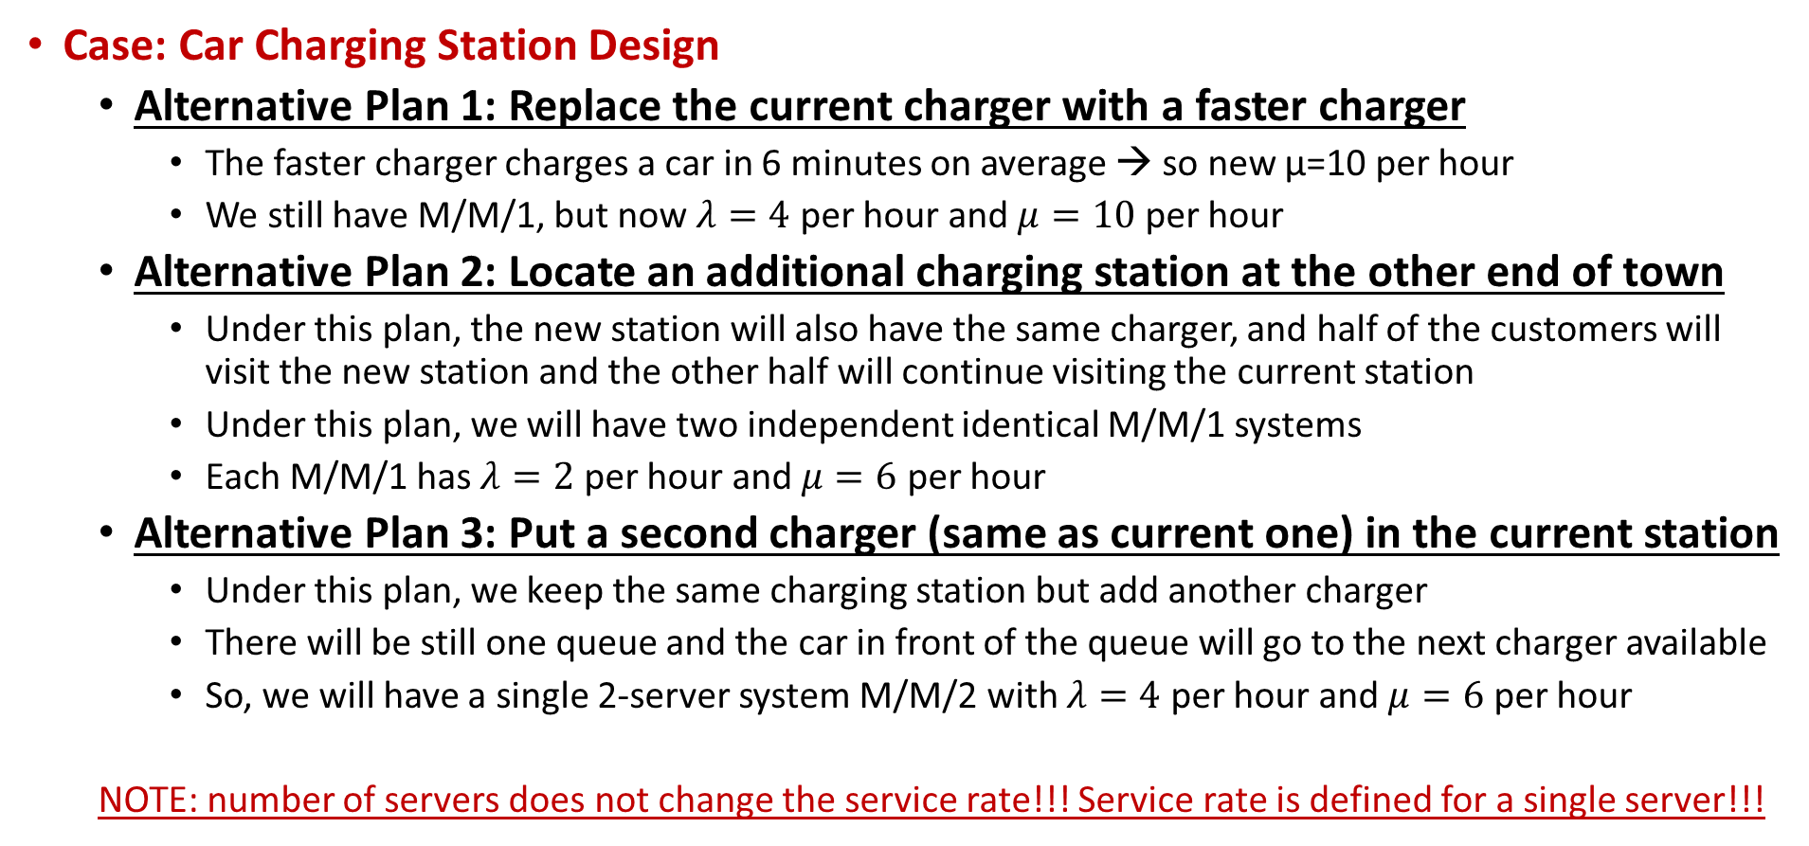
Case Study – Systematic Analyses
Case: Car Charging Station Design
  Alternative Plan 1: Replace the current charger with a faster charger
    The faster charger charges a car in 6 minutes on average → so new μ=10 per hour
    We still have M/M/1, but now $λ=4$ per hour and $μ=10$ per hour
  Alternative Plan 2: Locate an additional charging station at the other end of town
    Under this plan, the new station will also have the same charger, and half of the customers will visit the new station and the other half will continue visiting the current station
    Under this plan, we will have two independent identical M/M/1 systems
    Each M/M/1 has $λ=2$ per hour and $μ=6$ per hour
  Alternative Plan 3: Put a second charger (same as current one) in the current station
    Under this plan, we keep the same charging station but add another charger
    There will be still one queue and the car in front of the queue will go to the next charger available
    So, we will have a single 2-server system M/M/2 with $λ=4$ per hour and $μ=6$ per hour
  NOTE: number of servers does not change the service rate!!! Service rate is defined for a single server!!!

Slide 17

Case Study – Systematic Analyses
Case: Car Charging Station Design
  Alternative Plan 1: Replace the current charger with a faster charger
    The faster charger charges a car in 6 minutes on average → so new μ=10 per hour
    We still have M/M/1, but now $λ=4$ per hour and $μ=10$ per hour
☺
☺
☺
☺

Slide 18

Case Study – Systematic Analyses
Case: Car Charging Station Design
  Alternative Plan 2: Locate an additional charging station at the other end of town
    Under this plan, we will have two independent identical M/M/1 systems
    Each M/M/1 has $λ=2$ per hour and $μ=6$ per hour
☺
☺
☺
Note that these are for one of the M/M/1 systems
From a customer perspective, the satisfaction standards does not matter
About numbers, if we want to look at avg. total # of cars waiting for charging in San Marcos, we would look at 2Lq
☺

Slide 19

Case Study – Systematic Analyses
Case: Car Charging Station Design
  Alternative Plan 3: Put a second charger (same as current one) in the current station
    So, we will have a single 2-server system M/M/2 with $λ=4$ per hour and $μ=6$ per hour
☺
☺
☺
☺

Slide 20
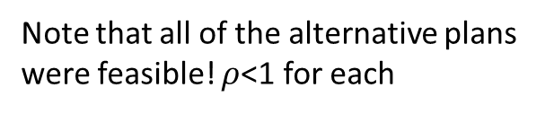
Case Study – Systematic Analyses
Case 1: Car Charging Station Design
  Comparing current systems and alternatives:
  See ‘Module 2.2 - Car Charging Station Design Case.xlsx’
Note that all of the alternative plans were feasible! $ρ$<1 for each
Looks like Alternative Plan 3 is the best in terms of happy customers!

Slide 21
Case Study – Economic Analyses
Case: Workstation Setup Design
  Suppose that you are the manager of a workstation that processes a product your company sells. Specifically, you are in control of three machines that can be used in the processing. These machines can be programmed such that a machine can complete the whole or some of the processing operation. Currently, you are considering re-designing your workstation and you have three alternative setups (explained in the next slide)
  You will compare these alternative setups based on their expected total cost per hour
  Hourly cost includes the following:
    A machine costs $10 per hour for the times it is actively working on processing and only $2 per hour for the times it is idle
    A product waiting for the processing to start has a buffer area inventory holding cost of $4 per hour
    If a product takes less than 30 minutes to have its process completed, it is on time; otherwise, it is late and there is a penalty of $8 for a late product

Slide 22
Case Study – Economic Analyses
Case: Workstation Setup Design
  Alternative setups:
    Setup 1: Program each machine so that each machine can complete a whole process for a part. In this case, each machine can complete a whole process of a part in 12 minutes on average and the process time is exponentially distributed. Furthermore, you will set three sub-workstations; one for each machine such that each machine will have its own sub-workstation; and, each sub-workstation will have its own inventory space for parts waiting to be processed. In this setting, a part will arrive in a sub-workstation at every 15 minutes on average and the interarrival time is exponentially distributed.
    Setup 2: Similar to Setup 1, program each machine so that each machine can complete a whole process for a part. In this case, each machine can complete a whole process of a part in 12 minutes on average and the process time is exponentially distributed. Different than Setup 1, you will not have sub-workstations. Instead, you will have a single work-station and it will have its own inventory space for parts waiting to be processed. In this setting, a part will arrive in the workstation at every 5 minutes on average and the interarrival time is exponentially distributed. A part waiting will be processed by the next available machine.
    Setup 3: Program each machine such that they complete a specific part of the process of a part. In this case, all three machines will simultaneously work on completing a process operation. With three machines simultaneously working on the same process operation of a part, it takes 4 minutes to complete a process operation on average and the process time is exponentially distributed. Similar to Setup 2, you will have a single work-station and it will have its own inventory space for parts waiting to be processed. In this setting, a part will arrive in the workstation at every 5 minutes on average and the interarrival time is exponentially distributed.

Slide 23
Case Study – Economic Analyses
Case: Workstation Setup Design
  Setup 1: In this case, we have 3 identical M/M/1 systems, each of which has service rate μ=5/hour and arrival rate λ=4/hour.
  Cost calculation for one of the M/M/1 (then we will multiply the cost with 3)
    Expected servers cost/hour = (expected cost of a server/hour) X (# of servers)
      Expected cost of a server / hour = busy-rate * busy-cost + idle-rate*idle-cost = ρ*$10 + (1- ρ)*$2
      Expected servers cost/hour = 1* [ρ*$10 + (1- ρ)*$2]
    Expected customers cost/hour = (expected cost of a customer) X (expected # of customers/hour)
      Expected cost of a customer = expected inventory cost of a customer + expected penalty for a customer
        Expected inventory cost of a customer = inventory cost/hour * expected hours in inventory
          = $4*Wq
        Expected penalty for a customer = probability of penalty * penalty
          = Prob(W>30minutes) *$8 = Prob(W>0.5hours) *$8
        Expected cost of a customer = $4*Wq+$8* P(W>0.5)
      Expected customers cost/hour = [$4*Wq+$8* P(W>0.5) ] * λ
    Cost of one M/M/1 is = [ρ*$10 + (1- ρ)*$2] + [$4*Wq+$8* P(W>0.5) ] * λ
      Multiply that with 3 to get the total exp. cost/hour for Setup 1

Slide 24
Case Study – Economic Analyses
Case: Workstation Setup Design
  Setup 2: In this case, we have one M/M/3 system with service rate μ=5/hour for a server and the arrival rate λ=12/hour.
  Cost calculation for the M/M/3
    Expected servers cost/hour = (expected cost of a server/hour) X (# of servers)
      Expected cost of a server / hour = busy-rate * busy-cost + idle-rate*idle-cost = ρ*$10 + (1- ρ)*$2
      Expected servers cost/hour = 3* [ρ*$10 + (1- ρ)*$2]
    Expected customers cost/hour = (expected cost of a customer) X (expected # of customers/hour)
      Expected cost of a customer = expected inventory cost of a customer + expected penalty for a customer
        Expected inventory cost of a customer = inventory cost/hour * expected hours in inventory
          = $4*Wq
        Expected penalty for a customer = probability of penalty * penalty
          = Prob(W>30minutes) *$8 = Prob(W>0.5hours) *$8
        Expected cost of a customer = $4*Wq+$8* P(W>0.5)
      Expected customers cost/hour = [$4*Wq+$8* P(W>0.5) ] * λ
    Cost of the M/M/3 is = 3*[ρ*$10 + (1- ρ)*$2] + [$4*Wq+$8* P(W>0.5) ] * λ
      This is the total exp. cost/hour for Setup 2

Slide 25
Case Study – Economic Analyses
Case: Workstation Setup Design
  Setup 3: In this case, we have one M/M/1 system with service rate μ=15/hour and the arrival rate λ=12/hour.
  Cost calculation for the M/M/1
    Note that 3 machines, as a group, is one server, so server busy-cost is $30/hr and server-idle cost is $6/hr
    Expected servers cost/hour = (expected cost of a server/hour) X (# of servers)
      Expected cost of a server / hour = busy-rate * busy-cost + idle-rate*idle-cost = ρ*$30 + (1- ρ)*$6
      Expected servers cost/hour = 1*[ρ*$30 + (1- ρ)*$6]
    Expected customers cost/hour = (expected cost of a customer) X (expected # of customers/hour)
      Expected cost of a customer = expected inventory cost of a customer + expected penalty for a customer
        Expected inventory cost of a customer = inventory cost/hour * exp. hours in inventory = $4*Wq
        Expected penalty for a customer = probability of penalty * penalty
          = Prob(W>30minutes) *$8 = Prob(W>0.5hours) *$8
        Expected cost of a customer = $4*Wq+$8* P(W>0.5)
      Expected customers cost/hour = [$4*Wq+$8* P(W>0.5) ] * λ
    Cost of the M/M/3 is = [ρ*$30 + (1- ρ)*$6] + [$4*Wq+$8* P(W>0.5) ] * λ
      This is the total exp. cost/hour for Setup 3

Slide 26
Case Study – Economic Analyses
Case: Workstation Setup Design
  Comparison:
  See ‘Module 2.2 - Workstation Setup Design Case.xlsx’
  So, choose Alternative Setup 3!
    Note that, all of the alternatives have the same (expected) total servers cost/hour

Slide 27
Outline
Evaluating Queueing Systems
Analyses
  Systematic Analyses: Case – Car Charging Station Design
  Economic Analyses: Case – Workstation Setup Design
Further concepts
  Priority Queues
  Queueing Networks

Slide 28
Priority Queues
General settings:
  There are two or more categories of customers. Each category is assigned to a priority class. Customers in priority class 1 are given priority over customers in priority class 2. Priority class 2 has priority over priority class 3, etc.
  After deferring to higher priority customers, the customers within each priority class are served on a first-come-fist-served basis.
Two types of priorities:
  Nonpreemptive priorities: Once a server has begun serving a customer, the service must be completed (even if a higher priority customer arrives). However, once service is completed, priorities are applied to select the next one to begin service.
  Preemptive priorities: The lowest priority customer being served is preempted (ejected back into the queue) whenever a higher priority customer enters the queueing system.

Slide 29
Priority Queues
M/M/c priority queues:
  For priority class i (i = 1, 2, … , n), the interarrival times of the customers in that class have an exponential distribution with a mean of 1/λ_{i}.
  All service times have an exponential distribution with a mean of 1/μ, regardless of the priority class involved.
  The utilization factor for the server is: ρ = (λ₁ + λ₂ + … + λ_{n}) / cμ
  M/M/1 Preemptive (c=1 only): M/M/c Non-preemptive:
See ‘Module 2.2 - MMc Priorities.xlsx’

Slide 30
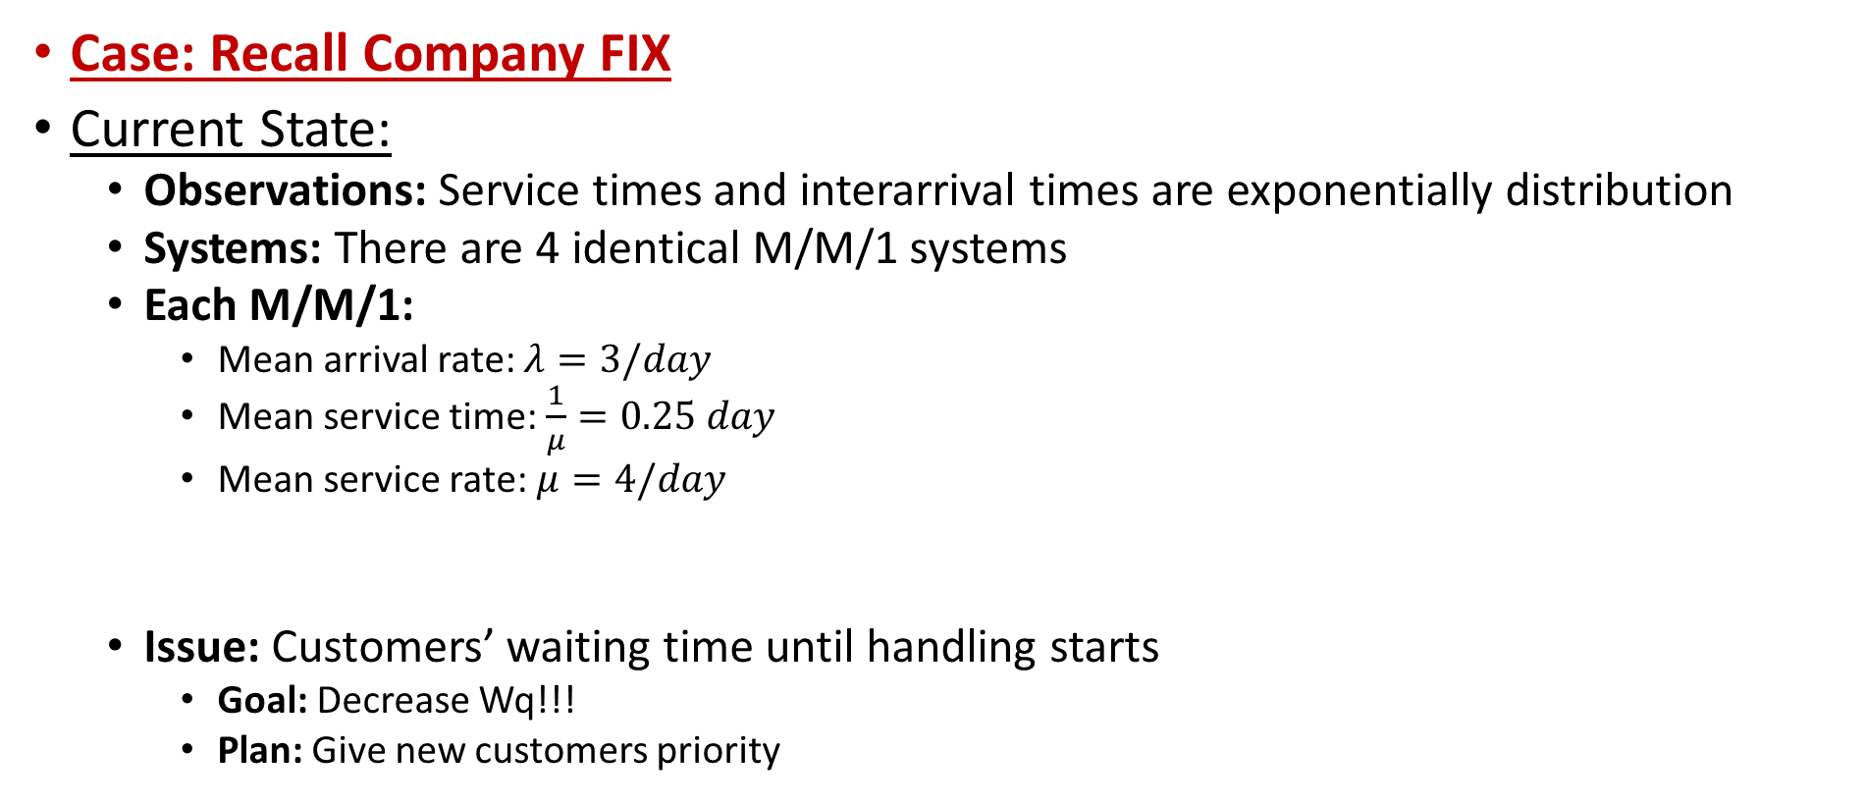
Priority Queues
Case: Recall Company FIX
Current State:
  Observations: Service times and interarrival times are exponentially distribution
  Systems: There are 4 identical M/M/1 systems
  Each M/M/1:
    Mean arrival rate: $λ=3/day$
    Mean service time: $\frac{1}{μ}=0.25 day$
    Mean service rate: $μ=4/day$
  Issue: Customers’ waiting time until handling starts
    Goal: Decrease Wq!!!
    Plan: Give new customers priority

Slide 31
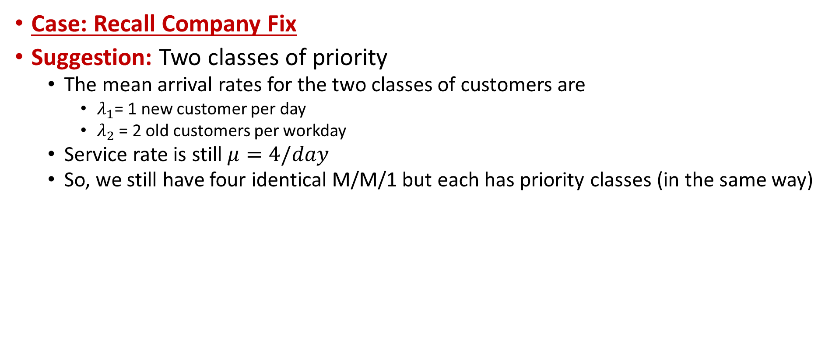
Priority Queues
Case: Recall Company Fix
Suggestion: Two classes of priority
  The mean arrival rates for the two classes of customers are
    $λ_{1}$= 1 new customer per day
    $λ_{2}$ = 2 old customers per workday
  Service rate is still $μ=4/day$
  So, we still have four identical M/M/1 but each has priority classes (in the same way)
M/M/1 Preemptive:
M/M/1 Non-preemptive:

Slide 32
Queueing Networks
Consist of nodes, each of which is a G/G/c (a general) station, connected by arcs representing possible entity travel between nodes
  Can also have entity arrivals from outside the network, and entities can exit from any node to outside the system
  When an entity leaves a node, it can go out on any of the arcs emanating from that node, with arc probabilities summing to 1
Assume:
  All arrival processes from outside have
  exponential interarrival times (a.k.a.
  Poisson processes), and are independent
  of each other
  All service times are independent
  exponential (so each node is an M/M/c)
  All queue capacities are infinite
  Utilization (a.k.a. traffic intensity) ρ
  locally at each node is < 1
Called a Jackson network with these assumptions; much is known about it

Slide 33
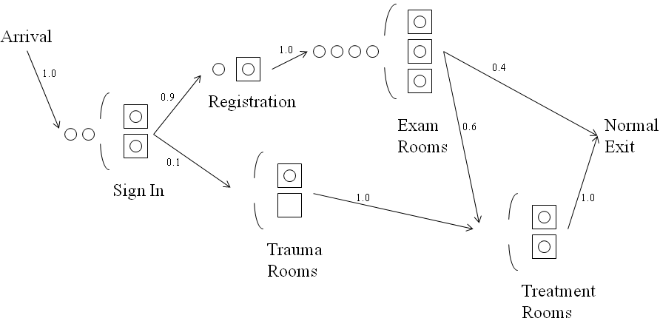
Queueing Networks
Use all of this to analyze each node in a Jackson network as a stand-alone M/M/c queue, using formulae given earlier
  Just have to compute Poisson arrival input/output rates using Poisson process properties
  Let λ_{SignIn} be the arrival rate into the Sign In station and assume exponential service times throughout
Analyze each node independently as:
Sign In: M/M/2, arrival rate λ_{SignIn}
Registration: M/M/1, arrival rate λ_{Reg} =0.9λ_{SignIn}
Trauma Rooms: M/M/2, arrival rate λ_{Trauma} = 0.1λ_{SignIn}
Exam Rooms: M/M/4, arrival rate λ_{Exam} =1 λ_{Reg} = 0.9λ_{SignIn}
Treatment Rooms: M/M/2, arrival rate λ_{Treat}
λ_{Treat} =1 λ_{Trauma}+0.6λ_{Exam} = 0.1λ_{SignIn}+(0.6)(0.9) λ_{SignIn} =0.64 λ_{Reg}

Slide 34
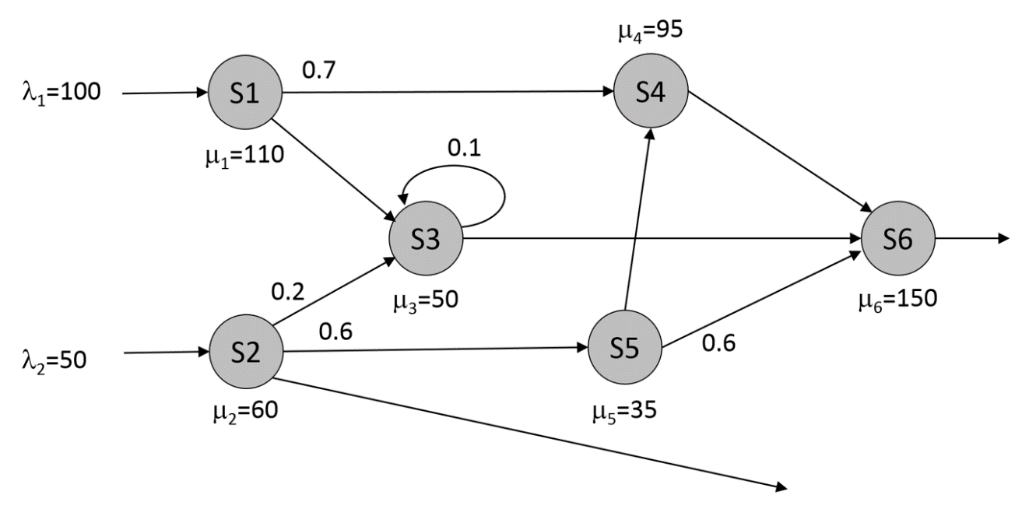
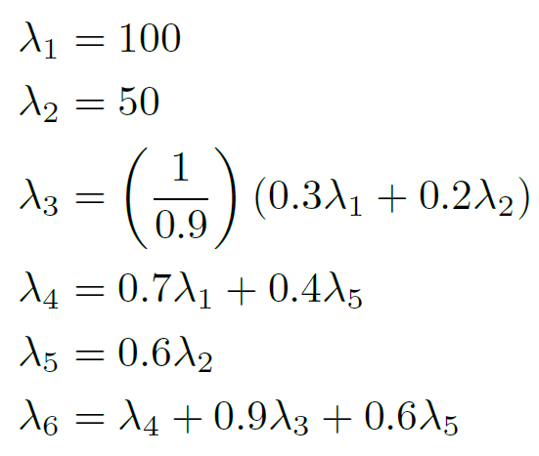
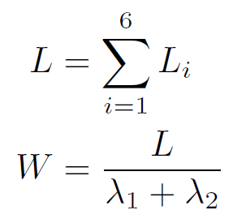
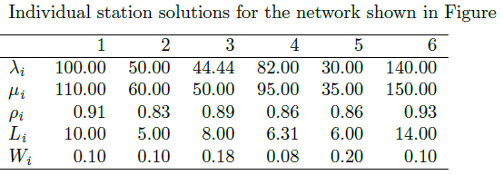
Queueing Networks
A small Jackson Network example:
λ₃=0.3 λ₁+0.2 λ₂+0.1 λ₃
Overall expected number of customers in the system
Expected amount of time a customer spends in the overall system
Recall L = λW where λ is the total arrival rate to the network (not individual stations), and here, it is λ= λ₁+ λ₂

Slide 35
Review and Key Insights
Economic Analyses: Customer costs, server costs, average system profit/cost
Systematic Analyses: Some standards, service goals/levels
Priority queues: Preemptive vs. Nonpreemptive
Queueing Networks: Each node is a queueing system by itself
  When each node is M/M/c, then we have Jackson Network
  Little’s Law still applies!
Key Insights:
  Elements and processes in a system: understanding the system definition
  Key performance measures and their relations, Little’s law
  Various systems have varying characteristics
  Server utilization is very important for performance
  Pooling servers can improve performance

